Slide 1
Dealing with FEAR

Slide 2
Dealing with Fear

Slide 3
If I can review . . . Fear is . . .
The unwillingness to risk
A feeling of anxiety concerning the outcome of something, or the safety and well-being of someone
The likelihood of something unwelcome happening

Slide 4
What IF??
The likelihood of something unwelcome happening – what if the fear worked in our favor?
Business Closure
Losing Job
Income Decrease
Stock Market

Slide 5
How do we? Risk to Reward Ratio
With Business ownership we have a clearer picture of risk to reward ratios when we calculate VALUES (time, money, effort, and responsibility) and the precise ways one measures rewards in ‘MEANS’ not just result ie. security, challenge, contribution, time, control etc.

Slide 6
Understand the clients Values
People are unwilling to risk what they Highly Value
QSR
Buyer Motives are Motives and Values
Hierarchy of Values lists; in order the clients Values
Wild Cards = possible pain
Meta Programs – Direction Sort

Slide 7
Another way to think about it
Risk Reward
Value to Means

Slide 8
Hierarchy of Values
Are listed on the Personal Franchise Assessment, and unlike the Buyer Motives, and spider webs, are Individual to each client.
It is a listing of that clients Top 6 Values
Wild Cards are listed in orange
Wild Cards may indicate a recent change, something amiss or redirecting of focus
Pain Point
Use these to create trust and SAFETY

Slide 9
Fear is a Perception - - Build Trust
What can we do to build trust?
Use Hierarchy of values
Use Meta Programs – Coach the client using THEIR preferred method

Slide 10
How do I build trust?
Put on your Coaches Hat, take off your Sales Hat!
Listen (WAIT)
Bring out your Sandler
Upfront Contracts
Ask Questions
Telling is selling
Windmill
Be careful not to paint seagulls
Handle concerns by guiding/coaching on how to collect factual information
Show understanding – don’t discount fear
Use Franchisor – frick & frack
Use Validation with Franchisees – provide stylized questions

Slide 11
Fear - The unwillingness to risk
Our question needs to be “RISK WHAT?”
More Importantly
How can we create SAFETY?

Slide 12
Safety
The state of being safe; freedom from the occurrence or risk of injury, danger, or loss.
Secure from liability to harm, injury, danger, or risk
Notes:
Maslov's Hierarchy of Human Needs - one of the basic needs is to feel safe along with the physiological necessity of food, water, air & shelter. How can that relate to other animals?
In the case of domestic animals, humans are responsible for meeting most of their physiological needs and also creating an environment where the animals will either feel safe or unsafe.
Perhaps there are some animals who feel "safer" giving up control than others. The feeling of safety may come from having a person who you trust be consistent and fair and one who "listens".
If the animal does not feel safe and control is simply taken, as in the case of dogs who are pinned on their backs or "dominated" in some other way, then it appears that every individual person, who deals with the dog, needs to repeat the action in order for the animal to "submit".
12

Slide 13
Our Fear Report Measures
The 4 primary risks
Social
Emotional
Relational
Financial

Slide 14
Risk – Resources = Fear

Slide 15
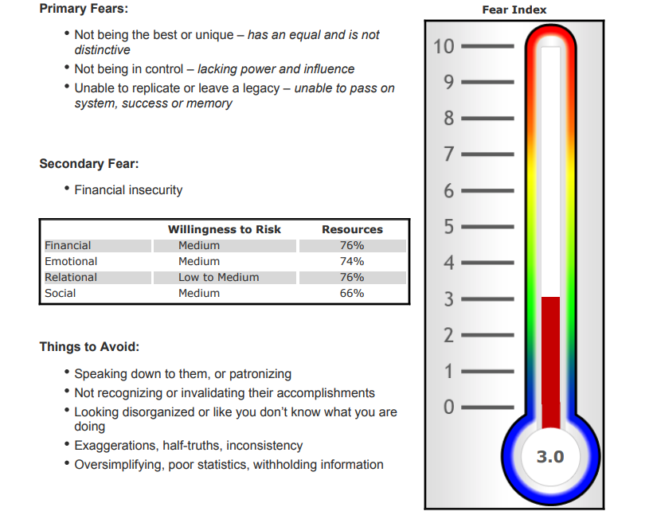
Risk – Resources = Fear

Slide 16
Primary Risks
Social - What will others think
If I fail what will others think of me? Of my ability?
Emotional – Self Confidence, Skillset & Knowledge
I was just downsized, what if I do not have the skillset or knowledge?
Relational – Couple, Spousal ambush
Will it matter to me what my spouse thinks?
Financial – ability to lose
What if I lose my money?

Slide 17
Safety First
High Score requires more awareness on your part to provide Safety for your client.
Safety for you might be very different than Safety for your client.
Just because we have the resources to risk, doesn’t mean the client has the resources

Slide 18
Fear is the Unwillingness to Risk
Ironic isn’t it?
One can have ample Resources but be unwilling to Risk.
Resources are not always an indicator of Perceived Risk.

Slide 19
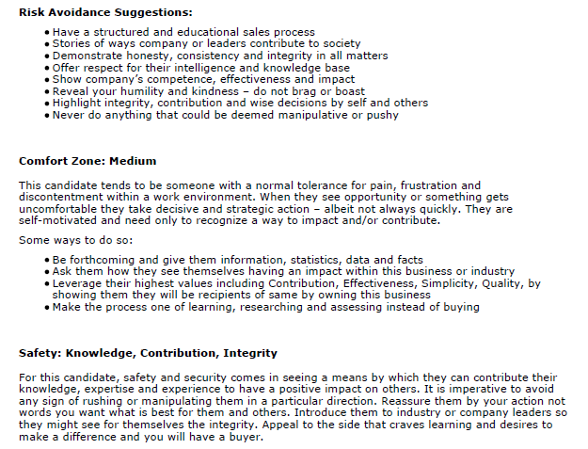

Slide 20
Comfort Zone
Comfort Zones differ from person to person
The larger the comfort zone, the less likely they are to make a change
The larger the comfort zone, the more we need to leverage the pain
REVIEW OFTEN: Risk vs. Reward

Slide 21
Create Safety
Wild Card– is the pain your prospect is currently experiencing. Leverage it to move them towards a decision.
Fear Factor – the perception of risk to resources. Safety for you might be very different than safety for your client.

Slide 22
What if IT already happened??
The likelihood of something unwelcome happening – What if the fear worked in our favor?
Business Closure
Losing Job
Income Decrease
Stock Market

Slide 23
If IT already happened . . .
It may be easier to hand over the reins when we:
Trust the skill level of another
Trust that we will be heard
Trust our needs will be met
Trust the referral of another

Slide 24
So . . . if IT already happened??
IT
Who sees our client First?
Business Closure
Losing Job
Income Decrease
Stock Market
Outplacement
Professional Contacts
Former Clients
Friends/Family
Other
Current Clients

Slide 25
We Know
FranNets two Highest Deal sources by FAR are Outplacement and Referrals
1. Outplacement – the firms
2. Referrals
Professional Contacts
Former Clients
Friends/Family
Other
Current Clients

Slide 26
Outplacement and Referrals
How can we get thru the fear to get more leads?
Take the process back a step to the referral source
Look through your past years. Are some of your referral partners quiet now due to Covid?
If they are fearful of the market/industry – no referrals
Drip on our Referral Partners
Take the stories back to the origin ( Outplacement & Referral )

Slide 27
Outplacement and Referrals
How can we get thru the fear to get more leads?
We can speak with our partners directly about how we are overcoming the fears
Franchises are not failing
Concepts pivoting during Covid
Fitness – online programing
Industries growing during Covid
Food, home services
Proven Systems
Success Stories
Of their past referrals who are doing well
Current Clients - or Bio’s Chris & Liann are putting out there.

Slide 28
Outplacement and Referrals
How can we get thru the fear to get more leads?
Follow Up with referral partner as client moves thru the process – ie.
High Touch for the referral partner
Referral fees or ‘landing’ baskets for Outplacement
Client Success stories
Make it easier for them – place a story on their letterhead or joint brand
Use data that relates to your geography
Swimming pool starts
Essential businesses in your state

Slide 29
Extraordinary Times Call For Extraordinary Measures
Take our process back a step to the referral partner
Leverage ALL of the FranNet tool Box
Be the Consultant, not the sales person
Buyer Motives are what the Values most
Hierarchy of Values lists; in order the client’s values
Wild Cards = possible pain
Meta programs – tell us how the client processes, learns and makes decisions
Fear Report to understand what resources the client has available
Use the comfort zone to leverage the pain/fears

